Slide 1
Module 4: Optical Network System Components and Optical Networks
EXTC – BE – Optical Communication (ECC801)
Prof. Shyamala Mathi
Assistant Professor
Dept. of Electronics and Telecommunication,
SIES Graduate School of Technology

Slide 2
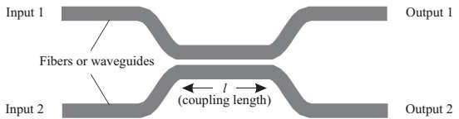
Couplers/ Splitters
A directional coupler is used to combine and split signals in an optical network.
A 2×2 coupler consists of two input ports and two output ports.
The most commonly used couplers are made by fusing two fibers together in the middle—these are called fused fiber couplers.
A 2×2 coupler, takes a fraction α of the power from input 1 and places it on
output 1 and the remaining fraction 1−α on output 2.

Slide 3
Couplers/ Splitters
Similarly, a fraction1−α the power from input 2 is distributed to output 1 and the remaining power to output 2.
We call α the “coupling ratio”.
The coupler can be designed to be either wavelength selective or wavelength independent (sometimes called wavelength flat) over a usefully wide range.
Wavelength- independent device, α is independent of the wavelength.
Wavelength selective device, α depends on the wavelength.
3 dB coupler, a coupler can be used to distribute an input signal equally among two output ports if the coupling length(l), is adjusted such that half the power from each input appears at each output. Such a coupler is called a 3 dB coupler.

Slide 4
Couplers/ Splitters
A coupler can be made wavelength selective, meaning that its coupling coefficient will then depend on the wavelength of the signal.
Such couplers are widely used to combine signals at 1310 nm and 1550
nm into a single fiber without loss.
These types of couplers are used for optical amplifiers.
Couplers and most other passive optical devices are reciprocal devices in that the devices work exactly the same way if their inputs and outputs are reversed.
In many systems there is a need for a passive non reciprocal device.

Slide 5
Couplers: Principle of Operation
When two waveguides are placed in proximity to each other, light “couples” from one waveguide to the other.
This is because the propagation modes of the combined waveguide are quite different from the propagation modes of a single waveguide due to the presence of the other waveguide.
When the two waveguides are identical, light launched into one waveguide couples to the other waveguide completely and then back to the first waveguide in a periodic manner.
The coupling length in a 3 dB coupler must be chosen to satisfy κl=(2k+1)π/4, where k is a “non-negative integer”, l denotes the “coupling length”, The quantity κ is called the “coupling coefficient”.

Slide 6
Optical couplers:

Slide 8
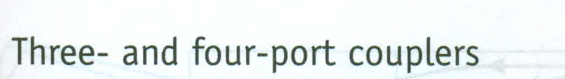

Slide 13
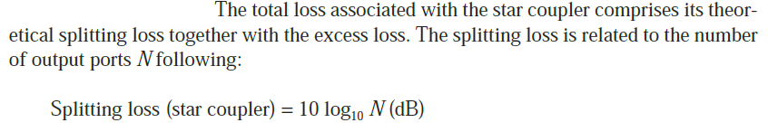

Slide 18
Isolator:
Isolators, main function is to allow transmission in one direction through it but block all transmission in the other direction.
Isolators are used in systems at the output of optical amplifiers and lasers primarily to prevent reflections from entering these devices, which would otherwise degrade their performance.
The two key parameters of an isolator are its insertion loss, which is the loss in the forward direction and which should be as small as possible, and its isolation loss, which is the loss in the reverse direction and which should be as large as possible.

Slide 19
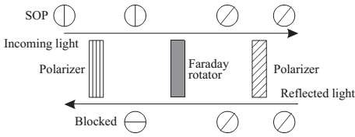
Isolators: Principle of Operation
In order to understand the operation of an isolator, we need to understand the notion of polarization.
The state of polarization (SOP) of light propagating in a single-mode fiber refers to the orientation of its electric field vector on a plane that is orthogonal to its direction of propagation.
I) Polarization sensitive component
A polarizer is an optical filter that lets light waves of a specific polarization pass through while blocking light waves of other polarizations.

Slide 20
Material used - Ferromagnetic Crystals
The rotation angle, β, is measured in radians and is defined as the product of the crystal's Verdet Constant, V; the magnetic flux density in teslas, B, along the direction of propagation; and the length of the crystal in meters, d.
The Verdet constant is a measure of the strength of the Faraday effect in a particular material, and a large Verdet constant indicates that the material has a strong Faraday effect and is more suitable for building an optical isolator

Slide 21
Backward direction
Forward direction
Faraday Rotator is non-reciprocal device but half wave plate is reciprocal

Slide 22
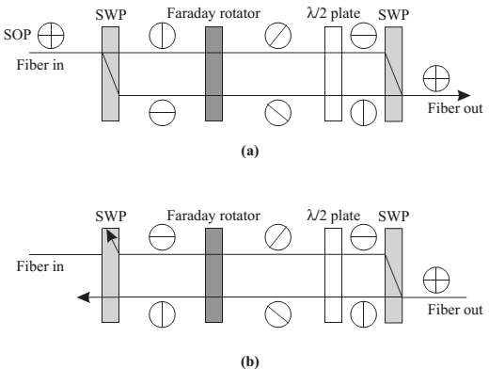
II) Polarization Insensitive Isolator
Half wave plate is reciprocal which means that if light wave is rotated by 45 degrees clockwise then in reverse process it will rotate light wave by 45 degrees anticlockwise.
Faraday rotator is non-reciprocal device.
SWP – Spatial Walk-off Polarization
SWP is also called as Birefringent Walk-off Block, which is made up of Calcite material. It exhibits double refraction

Slide 23
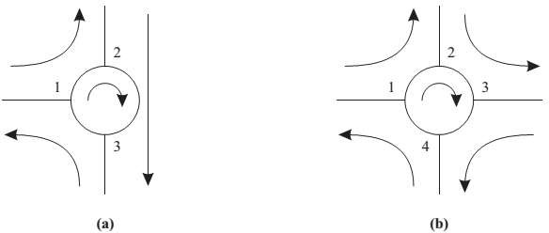
Circulators
A circulator is similar to an isolator, except that it has multiple ports, typically three or four.
In a three-port circulator, an input signal on port 1 is sent out on port 2, an input signal on port 2 is sent out on port 3, and an input signal on port 3 is sent out on port 1.
Circulators are useful to construct optical add/drop elements.
Circulators operate on the same principles as isolators.

Slide 24
Circulator

Slide 25
Circulator

Slide 26
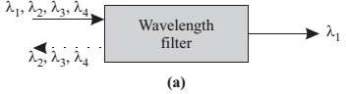
Multiplexers and Filters
Optical filters are essential components in transmission systems for at least two applications: to multiplex and demultiplex wavelengths in a WDM system.
These devices are called multiplexers/ demultiplexers and to provide equalization of the gain and filtering of noise in optical amplifiers.
A simple filter is a two-port device that selects one wavelength and rejects
all others.
It may have an additional third port on which the rejected wavelengths can be obtained.

Slide 27
0.8 nm - 80 channels
1528 nm
1566 nm

Slide 28
WDM Couplers
Lithrow mounted diffraction grating with conventional lens
Diffraction grating with Grin rod lens
Multilayer Interference filter
Multilayer Interference filter with Grin Rod Lens
Wavelength Filters
Lithrow mounted diffraction grating
Multilayer Interference Filter
Fiber Brag Grating
Fiber Grating (Slits)
Fabry Perot filter (Thin Film Filter)
Arrayed Waveguide Grating

Slide 29
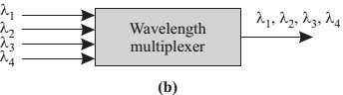
Multiplexers and Filters
A multiplexer combines signals at different wavelengths on its input ports onto a common output port, and a demultiplexer performs the opposite function.
Multiplexers and demultiplexers are used in
WDM terminals
Larger wavelength cross connects, and
Wavelength add/drop multiplexers.
A multiplexer, which combines multiple wavelengths into a single fiber. In the reverse direction, the same device acts as a demultiplexer to separate the different wavelengths.

Slide 30
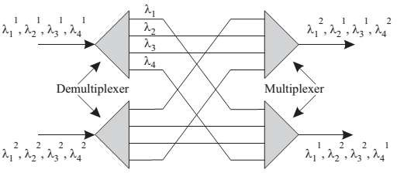
Multiplexers and Filters
A static wavelength cross connect (WXC) is a device which routes optical signals from an input port to an output port based on the wavelength.
Demultiplexers & multiplexers can be wavelength cross connects (WXCs).

Slide 31
The cross connect pattern in a static WXC is fixed at the time of manufacturing the device and cannot be changed dynamically.
It is used for routing signals from an input port to an output port based on the wavelength.
The problem with static WXCs is that they are highly limited in terms of their functionality.
Therefore, dynamic WXCs are preferred over the static WXCs.
We can construct the dynamic WXCs by using a combination of optical switches with multiplexers and demultiplexers.

Slide 33
Fiber Gratings
Gratings, use the diffraction property—light from a source tends to spread in all directions depending on the incident wavelength.
The term grating is used to describe almost any device whose operation involves interference among multiple optical signals originating from the same source but with different relative phase shifts
Principle of Operation
Consider the light transmitted through adjacent slits as shown in Figure.
The distance between adjacent slits—the pitch of the grating—is denoted by a.
Light can be assumed to be incident at the same angle θi to the plane of the grating at each slit.
The light rays diffracted at an angle θd from the grating plane.

Slide 34
Fiber gratings are attractive devices that can be used for a variety of applications, including filtering, add/drop functions, and compensating for accumulated dispersion in the system.
Being all-fiber devices, their main advantages are their low loss, ease of coupling (with other fibers), polarization insensitivity, low temperature-coefficient, and simple packaging.
As a result, they can be extremely low-cost devices.

Slide 35
The path length difference between the rays traversing through adjacent slits is the difference in lengths between the line segments AB and CD and is given approximately by a[sin(θi) − sin(θd )].
Thus constructive interference at a wavelength λ occurs at the imaging plane among the rays diffracted at angle θd if the following grating equation is satisfied:
a[sin(θi) − sin(θd )] = mλ
for some integer m, called the order of the grating.
Different wavelengths are diffracted at the angles at which the grating equation is satisfied for that wavelength.
For example, θd1 is the angle at which the grating equation is satisfied for λ1.

Slide 36
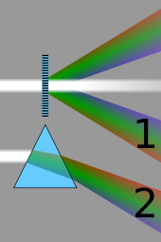

Slide 37
Thin Film Filter or Fabry-Perot Filter
Fabry-Perot filter consists of the cavity formed by two highly reflective mirrors placed parallel to each other, as shown in Figure.
This filter is also called a Fabry-Perot interferometer or etalon.
The input light beam to the filter enters the first mirror at right angles to its surface.
The output of the filter is the light beam leaving the second mirror.

Slide 38
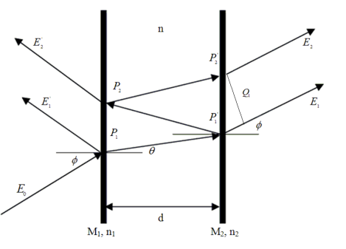
Principle of Operation
The principle of operation of the device is illustrated in Figure.
The input signal is incident on the left surface of the cavity.
After one pass through the cavity, as shown.
A part of the light leaves the cavity through the right facet and a part is reflected.
A part of the reflected wave is again reflected by the left facet to the right facet.
For those wavelengths for which the cavity length is an integral multiple of half the wavelength in the cavity—so that a round trip through the cavity is an integral multiple of the wavelength—all the transmitted light waves that add in phase comes out from right facet.
Such wavelengths are called the resonant wavelengths of the cavity.
Figure. Principle of operation of a Fabry-Perot filter.

Slide 39
Arrayed Waveguide Grating
Arrayed waveguide grating (AWG) consists of two multiport couplers interconnected by an array of waveguides.
The AWG is a device where several copies of the same signal, but shifted in phase by different amounts, are added together.
It can be used as an n × 1 wavelength multiplexer. It is an n-input, 1-output device,
Where the n inputs combined onto the single output.
The inverse of this function, namely, 1 × n wavelength demultiplexing, can also be performed using an AWG.
An AWG has lower loss and flatter passband, and is easier to realize on an integrated-optic substrate.
The input and output waveguides, the multiport couplers, and the arrayed waveguides are all fabricated on a single substrate.
Thirty-two–channel AWGs are commercially available, and AWGs are being used in WDM transmission systems.

Slide 40
Another way to understand the working of the AWG as a demultiplexer is to think of the multiport couplers as lenses and the array of waveguides as a prism.
The input coupler collimates the light from an input waveguide to the array of waveguides.
The array of waveguides acts like a prism, providing a wavelength-dependent phase shift, and the output coupler focuses different wavelengths on different output waveguides.
Figure. An arrayed waveguide grating.

Slide 41
Principle of Operation
Let the number of inputs and outputs of the AWG be denoted by n.
Let the couplers at the input and output be n × m and m × n in size, respectively.
Thus the couplers are interconnected by m waveguides.
We will call these waveguides as arrayed waveguides to distinguish them from the input and output waveguides.
The lengths of these waveguides are chosen such that the difference in length between consecutive waveguides is a constant denoted by L.

Slide 42
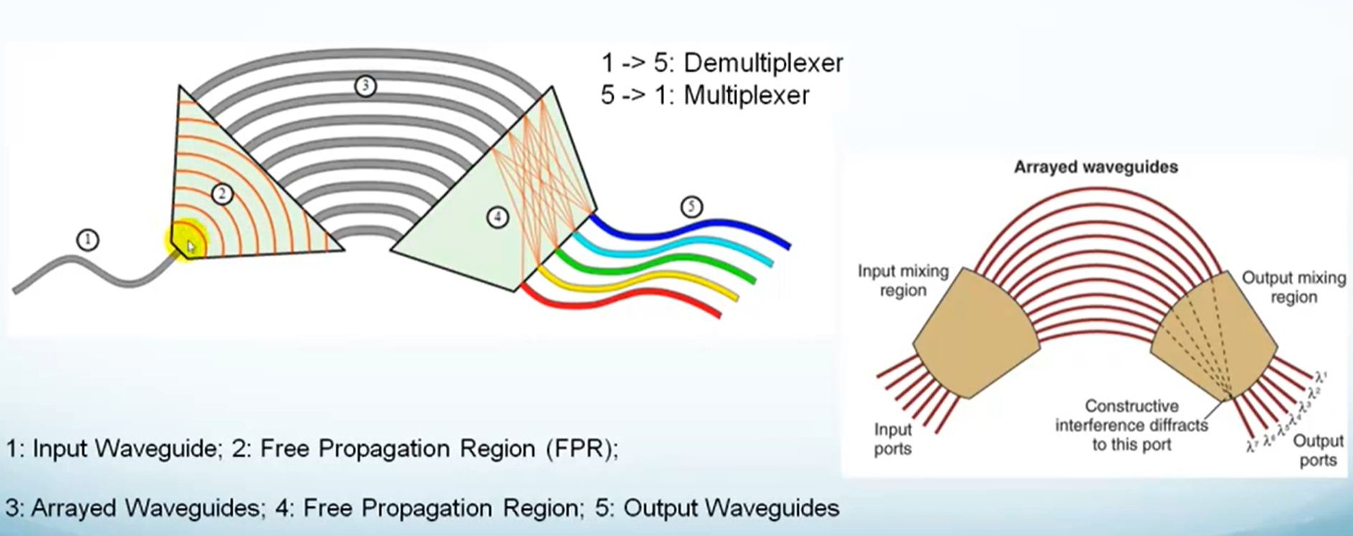

Slide 43
The evolution of single wavelength point-to-point transmission lines to wavelength division multiplexed optical networks has introduced a demand for wavelength selective optical add-drop multiplexers (OADMs) to seperate/route different wavelength channels. OADM is a device used in wavelength-division multiplexing systems for multiplexing and routing different channels of light into or out of a singlemode fiber (SMF). This is a type of optical node, which is generally used for the construction of optical telecommunications networks. "Add" refers to the capability of the device to add one or more new wavelength channels to an existing multi-wavelength WDM signal while "drop" refers to drop or remove one or more channels, passing those signals to another network path. An OADM may be considered to be a specific type of optical cross-connect.

Slide 44
Structure and Working Principle of OADM
OADM working process as follows: WDM signals from line contains N wavelength channel, enter the OADM "Main Input" side, depending on your business needs, from N wavelength channel, selectively from the road-side (Drop) required by the output wavelength channel, accordingly from the road-end (Add) enter the desired wavelength channel. Regardless of other local wavelength channel directly through the OADM, and routing wavelength channels multiplexed together, from the output terminals of the circuit of OADM (Main Output) output. The following picture shows the basic operation of an OADM.
Physically, there are several ways to realize an OADM. There are a variety of demultiplexer and multiplexer technologies including TFF(thin film filter), FBG(fiber bragg grating) with optical circulators, free space grating devices and integrated planar arrayed waveguide gratings (Optical add-drop multiplexer, using a fiber Bragg grating and two circulators as the following picture). The switching or reconfiguration functions range from the manual fiber patch panel to a variety of switching technologies including microelectromechanical systems (MEMS), liquid crystal and thermo-optic switches in planar waveguide circuits.

Slide 46
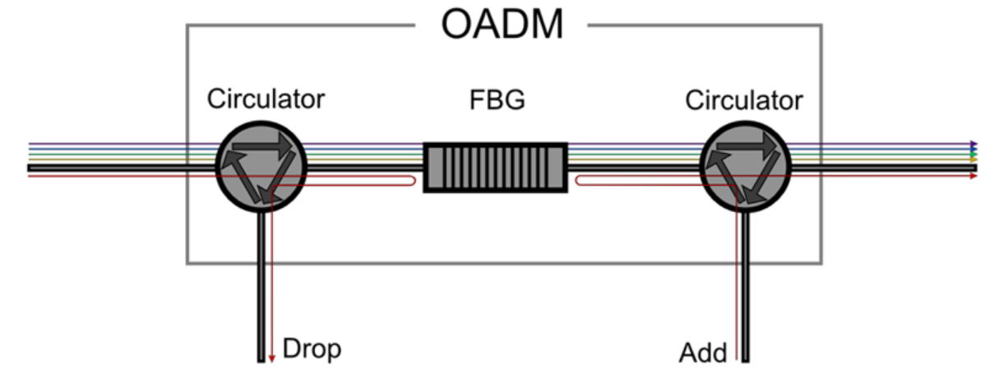

Slide 47
Thank You!
(shyamalae@sies.edu.in)

